Slide 1
Einführung in das Judentum
Treffen I: Einführung
Die jüdische Welt
27.10.11

Slide 2
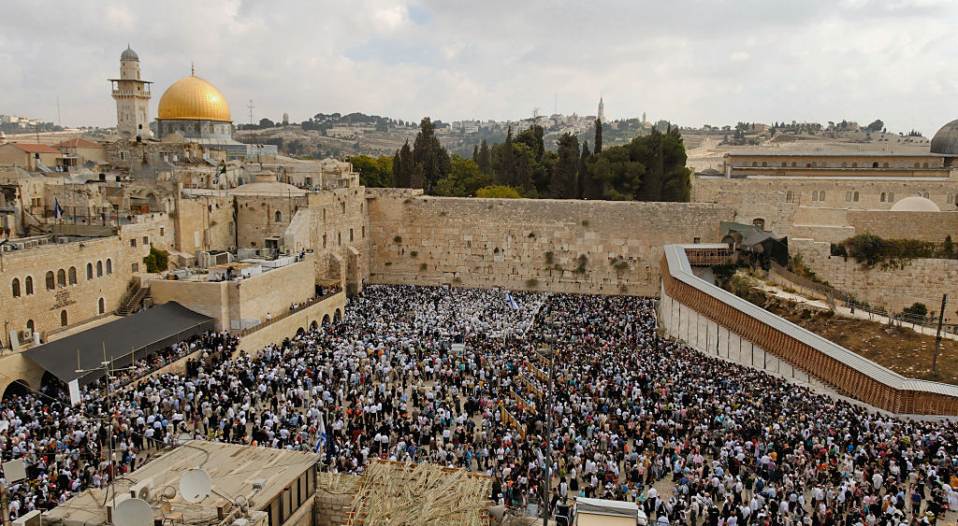

Slide 3
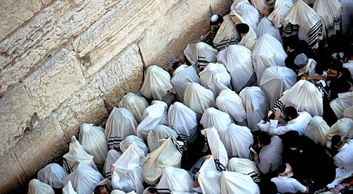

Slide 4
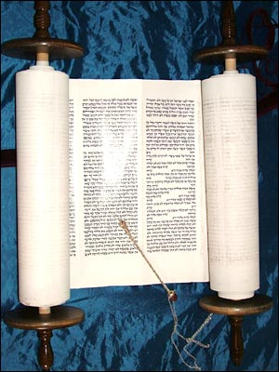

Slide 5
Fourteen Key Dates in Jewish History
1025-928 BCE: United Kingdom under Kings Saul, David, Solomon?
586 BCE: Destruction of Jerusalem and First Temple by Babylonian Empire
538 BCE: Edict of Return by Cyrus of Persia; temple rebuilt apprx. 20 years later
70 CE: Destruction of Jerusalem and Second Temple in Response to “Great Revolt” Against Rome
c. 200 CE: Compilation of Mishnah
c. 500 CE: Compilation of Babylonian Talmud
c. 1280 CE: composition of Zohar (“Book of Splendor”), authoritative work of Jewish mysticism
1492 CE: Expulsion of Jews from Spain
1567 CE: Publication of Shulkhan Arukh (“Set Table”), authoritative Jewish law code
18th century CE: Jewish Enlightenment (Haskalah) begins in Western Europe; Emergence of Hasidic movement in Eastern Europe
c. 1820 CE: Birth of Reform movement in Germany
1897 CE: First Zionist Congress in Basel, Switzerland
1941-45 CE: Holocaust
1948 CE: Foundation of State of Israel

Slide 6
Hillel and Shammai I
Another time a Gentile came before Shammai. He said to him, “I will convert on the condition that you teach me the entire Torah while I stand on one leg.” He drove him away with the builder’s cubit that was in his hand.
He came before Hillel. He converted him. He said to him, “That which is hateful to you, do not do to your fellow. That is the entire Torah. The rest is commentary. Go and learn it.”

Slide 7
Wie viele und wo sind die Juden?
Circa 13.4 Millionen “Core Jews”
(11 Millionen in 1945)
Wichtigste Centers:
Israel: 5.8 (6.1?) Millionen (75-80%)
U.S.A.: 5.2 (6?) Millionen (1.7%)
France: 483,000
Canada: 375,000
U.K.: 292,000

Slide 8
Wie viele und wo sind die Juden?
Weiter:
Russian Federation: 292,000
Argentinien: 182,000
Deutschland: 119,000 (200,000), .15%
Die meisten Juden oder in Israel oder N. Amerika
Circa 1.45 Millionen Juden in Europa

Slide 9
Die Wichtigste Jüdische Städte
1. Tel Aviv: 2.9 Milionen
2. New York: 2.0
3. Jerusalem: 700,000
4. Los Angeles: 684,000
Auch:
Paris: 284,000
London 195,000
Berlin: 11,000?, 30,000?

Slide 10
Immer Gruppen/Strömungen…
In der Antike: Phaisäer, Sadducäer, Essenäer
(und hellenisticher und nicht-hell. Juden)
In der späten Antike: Israel und Babylonien
In der frühen Mittelalter: Rabbanites und Karaites
Im Mittelater: Ashkenazim und Sepharadim
18. Jahrhundert: Hasidim (Ja oder Nein); Auklärung (Ja oder Nein)

Slide 11
Die Bewegungen des 19. Jahrhunderts …und bis heute
Reform
Conservative
Orthodox (Ultra, Modern, Hasidim)
(Die alle meist verbreitet in Deutschland, Nord Amerika)

Slide 12
Bewegungen in Israel
Sekulär (“Hiloni”)
Traditionel (“Massorti”)
Orthodox (“Dati”)
Ultra-Orthodox (“Haredi”)
(Reform und Massorti auch dabei, aber relativ klein)

Slide 13
Rabbinic Periodization
1. Tannaim/תנאים (to 200 AD) = Repeaters:
Follow the Five “Pairs”
Mishna (ca. 200), Tosefta (post Mishna)
2. Amoraim/אמוראים (200-500) = Speakers:
Talmuds (Babylonian and Jerusalem)
3. Savoraim/סבוראים (6th Century) = Explainers/Expositors (Babl.)
supplement and edit Babylonian Talmud
[also known as Stammaim/סתמאים = unattributed, unnamed
4. Geonim/גאונים (7th Century on) = Pride/Splendor
academy heads in Babylonia, "responsa literature"

